Slide 1
Yes, the kids are alright!
LGBT Parenting Research in litigation & Public policy
Cheryl Angelaccio, Lambda Legal
Naomi Goldberg, Movement Advancement Project
Notes:
Cheryl and I are very excited to be here today. Thank you to the conference organizations, Liz Megan, Joseph, and Chris, for inviting us and being such great hosts. Cheryl and I have many opportunities to chat with one another about our work, but I’m particularly excited to present with her today.

Slide 2
Yes, The Kids Are Alright!
Use of social science research in civil rights movements
Marriage equality litigation
What do we know about LGBT parenting?
Case study: Varnum v. Brien
Policy and advocacy
Pros and cons of using research
Notes:
Just to give you a sense of what Cheryl and I are going to talk about today, here’s an overview of our talk.
First, Cheryl is going to discuss the ways in which social science research has figured prominently in civil rights movements dating back many decades.
Then, Cheryl will give you a quick overview of the general arguments that are made in marriage equality cases so that you can begin to think about the ways in which social science, and particularly research about LGBT parents, might be useful.
I’m going to provide an overview of what we know about LGBT parenting, highlighting the various ways in which this research has been done and what the major takeaways are.
Then, Cheryl is going to use the Iowa marriage equality case, Varnum v. Brien, as a way to show how parenting research can be used in the courtroom as well as how researchers are crucial to litigation.
I will talk about other ways in which research is being used in advocacy and policy work, and finally the double edged sword that using research can present.
We’ll leave a healthy amount of time at the end for questions, too! While we’re going to speak primarily about parenting research, please think about the ways in which our experiences might be relevant to the important work that you’re doing.
Cheryl…

Slide 3
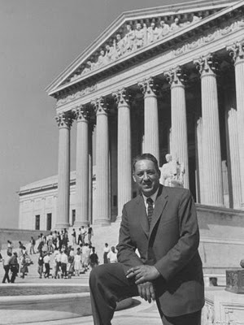
Social Science in the Racial Justice Civil Rights movement
Social scientists have played a major part in important civil rights litigation and public policy for decades
Sweatt v. University of Texas (1946)
Brown v. Board of Education (1954)
Fischer v. University of Texas (2012)

Slide 4
Social Science in the LGBT Civil Rights movement
Social scientists conduct research on the LGBT community in a variety of areas. The results often document our “normalcy” and the harms that the LGBT community has suffered (and continues to suffer).
The research is then used in:
Position statements
Court testimony and declarations
Hearing testimony to executive agencies and congressional committees

Slide 5
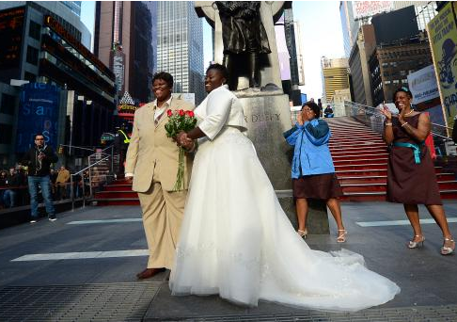
Marriage litigation, generally
Arguments for marriage equality
Due Process Clause: “liberty interest in the fundamental right to marry”
Equal Protection Clause: “prohibits government from discriminating against people without justification”
Discrimination based on sexual orientation and sex
Government has burden to justify

Slide 6
Marriage litigation, generally
Opponents argue
No fundamental right to “gay marriage”
No sexual orientation discrimination: “everyone can marry someone”
No sex discrimination
Good reasons exist to exclude gay and lesbian couples
Preserving traditional definition of marriage
Providing a stable social and familial environment in which procreation may take place
Providing the benefits of “dual-gender” parenting for children

Slide 7
Marriage “Scorecard”
WINS
Marriage: Goodridge v. Dept. of Public Health (Massachusetts, 2003)
Civil Unions: Baker v. Vermont (Vermont, 2000)
Civil Unions: Lewis v. Harris (New Jersey, 2006)
LOSSES
Hernandez v. Robles (New York, 2006)
Andersen v. King County (Washington, 2006)
Conaway v. Deane (Maryland, 2007)
Takeaway: Marriage bans encourage procreation in the “best possible environment” for children

Slide 8
What do we know?
Notes:
Given that courts and public opinion for many years held that the “best” environment for raising children was with married, heterosexual parents, it begs the question, what do we really know about parenting by LGBT people and the outcomes for their children?
For full disclosure, I will say that I’m only presenting a miniscule subsection of the research out there about LGBT parenting. And, since this is a conference focused on methodology, I am going to talk in broad terms about various kinds of studies and their findings.

Slide 9
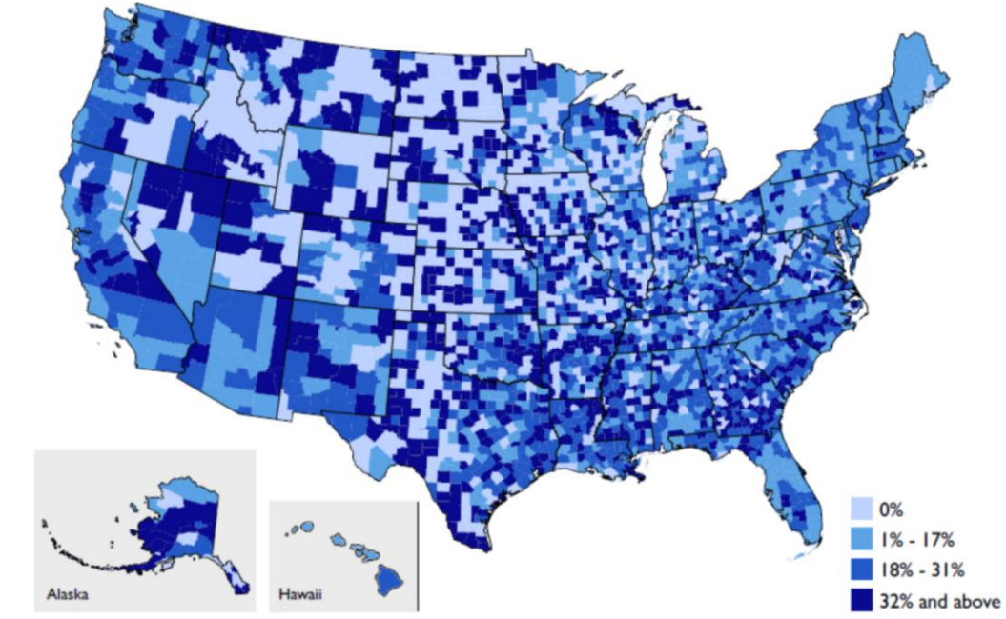
Do LGBT People Parent?
From national data sets…
U.S. Census and American Community Survey → same-sex couples only
% of Same-Sex Couples with Bio, Adopted, Foster Children Under 18
Source: Gates, GJ. LGBT Parenting in the United States. The Williams Institute. February 2013.
Notes:
In some ways, the very first question that people ask is, “Do LGBT people really parent?” Aside from recent images on TV and in the movies, the common perception of LGBT people is that we’re so-called “DINKS” – dual incomes, no kids – we’re white and we live in big cities. Now, lots of researchers have done a great job dispelling these myths. And, the same is true in terms of answering the first question, “Do LGBT people parent?”
As I’m sure that many of you know, very few national, representative surveys (particularly those fielded by federal or state governments) ask about sexual orientation, let alone gender identity.
But, researchers, particularly demographers and economists, have done a great job mining the data that is out there see what we can learn about LGBT people.
Let’s start big…
Census 2010 shows 650,000 same-sex couples in the US; 19% have a child under the age of 18 (27% female/11% male)
Same-sex couples are more likely to raise adopted children than different-sex couples (4x); 6x more likely to raise foster children
Same-sex couples with kids are more likely identify as people of color (39% of individuals in same-sex couples with kids are POC vs. 36% in different-sex couples)
As the map shows, childrearing among same-sex couples is highest in MS, WY, AK, ID, and MT, but generally in South, Mountain West, Midwest.
Others have mined Census data to look at labor force participation of individuals in same-sex couples, for example, to show that they look a lot like married, diff-sex couples in that one person is pretty attached to the labor force and one person is more of the caretaker, for example. Or that the wages of women in same-sex couples, which are usually higher than women in diff-sex married couples, are often higher because of the lack of kids.
Limitations of Census are obvious – only same-sex couples (don’t really know “sexual orientation”, nothing about single LGBT people, no question about gender identity, so transgender people are lost in this data); not longitudinal; decennial census is pretty short and ACS is still limited in questions (housing situation, income, educational attainment, mostly demographic data).
This data set is great for the who, what, where basics.

Slide 10
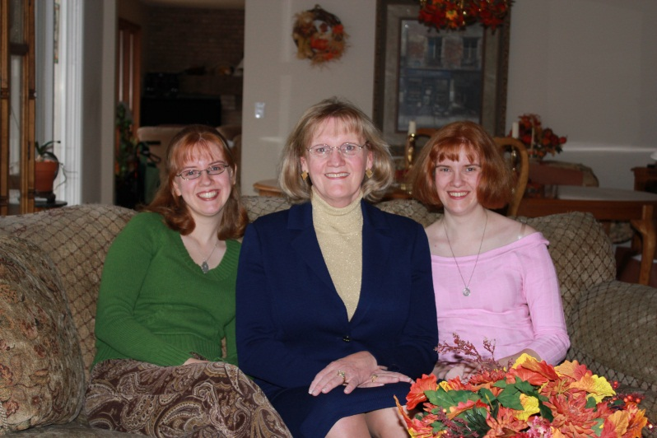
Do lgbt people parent?
From national data sets…
General Social Survey → sexual orientation only (attraction, behavior, and identity)
37% of LGB identified people have had a child
Gallup Daily Tracking Survey → HOT new data!
35% of LGBT people 50 or younger have a parental role with a child in the homes
From state-level surveys
California Health Interview Survey
From other large scale surveys…
National Transgender Discrimination Survey → largest survey of trans people
38% of respondents said they were parents
Source: Gates, GJ. LGBT Parenting in the United States. The Williams Institute. February 2013.
Notes:
Other national, representative surveys that are useful for this sort of demographic snapshot of parents include the General Social Survey and recently Gallup shows 48% of women; and 20% of men are raising kids (compared to 70% of comparable non-LGBT men and women).
There are a few good state-level surveys, and of course, when you can’t get the data that you want from someone else, you can always collect your own. So, the best big data set that we have about transgender people was compiled by the National Gay and Lesbian Task Force and the National Center for Transgender Equality. There were very few questions about parenting, but from this survey of nearly 6,500 people, we get a look into the trans and gender non-conforming community in a way that is light-years ahead of national gov’t surveys.
So, obviously being able to say “yes, there are LGBT parents is important.”

Slide 11
Are lgbt people “Good parents”?
Decades of social science research examining L(GBT) parenting
Primarily about lesbian families; more recent work on adoptive families, gay fathers
Particular focus on a few topics:
Gender identity and gender role behavior
Psychological adjustment
Stigmatization by peers
Sexual abuse by parents
Sexual orientation
Other topics include academic performance, substance use
Notes:
But very few of these types of surveys allow us to answer the question, “Are we any good at being parents? How do our kids do?” And, given the arguments that opponents to marriage equality (and adoption/foster care/parenting in general) make, so far, we’ve got very little to put forth.
And, this is where thirty years of research comes into play. Fortunately, we have thirty years of persistent, thoughtful researchers who were willing to study a topic that was controversial and rarely warranted funding.
Speaking in broad brush strokes, I would say that much of this work focuses on lesbian families – initially many of which were a result of previous heterosexual relationship and more recently those that are so-called “planned lesbian families.” There is much less about adoptive families or gay dads, although we’ll talk more about that in a bit.
And, I would say that there are several topics where researchers (and for that matter, advocates, policymakers, and opponents), seem to focus.

Slide 12
Yes, the kids are alright!
Decades of social science research examining L(GBT) parenting
In the UK → Golombok & Tasker met with children of lesbians and single heterosexual women in 1976-77 and then again in 1992-93; subsequent longitudinal studies
U.S. National Longitudinal Lesbian Family Study → ongoing study of planned lesbian families led by Nanette Gartrell
Started in 1986 by recruiting lesbians who were trying to get pregnant or were already pregnant using a donor
93% retention rate when children at 17 years old; plans to interview again
Notes:
I’m going to start by discussing several studies that I think are really fascinating – and to be honest – incredible research feats. I should note that I’m a collaborator on one of them, so I’m somewhat biased, but hopefully you’ll be similarly in awe of this work as I am.
In the UK, Golombok & Tasker followed 25 young adults raised in lesbian families and 21 young adults raised in single parent heterosexual households from the average age of 9.5 to 23.5. Had a 62% response rate.
Behavior (Flaks, Ficher 1995; Brewaeys 2002)
Gender roles (Golombok 2003; 1996)

Slide 13
Yes, the kids are alright!
National Longitudinal Study of Adolescent Health → Patterson and colleagues compared 44 adolescents who reported having two women in their household to 44 adolescents with a mother and father
Census Data → Rosenfeld looked at progress through school
Adoptive families → 27 lesbian, 29 gay, and 50 heterosexual couples who all adopted from the same agencies (Farr)
Adoptive families → ongoing Transition to Adoptive Parenthood Project, a longitudinal study; 150 couples since 2005 (A. Goldberg)
Notes:
Among others: Early childhood longitudinal study to look at math assessments (same-sex parented households) → outside of family transitions, no differences. Both Potter and Fedewa & Clark

Slide 14
No differences
Academic performance and cognitive development
Social development
Mental health
Sexual activity
Abuse
Substance use
Gender roles
Notes:
No differences in academic performance, social development, or mental health
Slightly older age of first sexual activity (less likely to impregnant someone, have an STD)
Similar in rates of alcohol, tobacco, and marijuana
Gender roles → toys that kids played with; aspirations… more egalitarian division of household labor were more flexible; some studies find no differences in masculinity of boys, but higher scores on femininity – no differneces for girls.

Slide 15
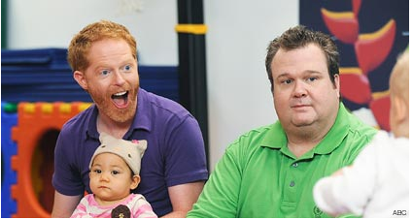
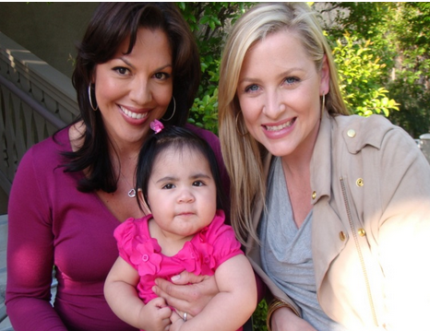
does it matter?
Custody battles between parents and family members
Adoption and foster care laws and policies
Marriage equality and relationship recognition
Shifts in public opinion and conversation
Overall climate for LGBT families

Slide 16
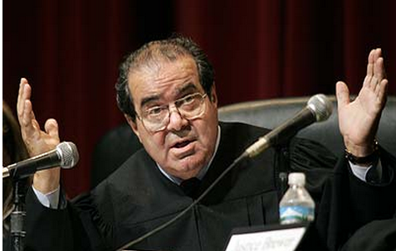
does it matter?
“There's considerable disagreement among–among sociologists as to what the consequences of raising a child in a–in a single-sex family, whether that is harmful to the child or not…
And so even though states that believe it is harmful–and I take no position on whether it's harmful or not–but it is certainly true that–that there's no scientific answer to that question at this point in time.”
- Justice Antonin Scalia during oral arguments Hollingsworth v. Perry (CA Prop 8 Case)

Slide 17
Using parenting research
In varnum v. brien (iowa marriage case)
Notes:
Naomi to transition back to Cheryl… who will talk about ways in which this research has been used in advancing LGBT rights – specifically on the issue of marriage and in Iowa, in particular.

Slide 18
Case study: Varnum v. brien
Decision to put gay and lesbian parenting research on trial
Use social science research on parenting to counter “common sense” notions
Decision wasn’t without controversy
Concerns about adverse findings of fact
Overall perception that we shouldn’t talk about children

Slide 19
Case study: Varnum v. brien
Two-pronged argument for why the marriage bans are not justified by any procreation or child welfare interest:
There is no connection in our marriage laws to procreation.
Social science shows that lesbian and gay parents are just as good parents, and their children turn out just as healthy, happy, and successful as the children of different-sex parents.

Slide 20
Challenges
Our lead attorney is just that, an attorney.
We needed experts, who would be willing to participate
What’s involved in being an expert witness
Explain data to court
Being deposed
Written report
Testifying on the stand
Experts who meet the standards of the court
Notes:
Needed to identify credible experts, and there are standards…

Slide 21
STANDARDS USED TO DETERMINE ADMISSABILITY
The Frye Test – general acceptance (Frye v. U.S., 1923)
The Daubert Standard (Daubert v. Merrell-Dow Pharmaceuticals, 1993)
Specified a gatekeeping role for judges, whereby the trial judge is called on to ensure that any and all scientific testimony is not only relevant, but reliable
Provided four factors that may be considered by a judge in assessing evidentiary reliability (i.e., scientific validity)
Whether the theory or technique can be (and has been) tested
Whether the theory or technique has been subjected to peer review and publication
Whether the known or potential rate of error is acceptable
Whether the method is generally accepted in the scientific community
Notes:
There are standards unbeknownst to Justice Scalia

Slide 22
Experts on our side in varnum
Pepper Schwarz - sociologist who studies relationships and the nature of sexual orientation
Gregory Herek - psychologist who testified about sexual orientation and the stigma, as well as the impact of antigay discrimination
Lee Badgett - economist and demographer who testified that we are out there in large numbers and we need legal protection.
Michael Lamb - developmental psychologist who testified about the research on parenting and adjustment of children of lesbian or gay parents
Others included historians Nancy Cott and George Chauncey

Slide 23
“Experts” on their side in varnum
Eight “experts” were named
Prepared summaries for each expert to provide foundation for deposition
Goal of deposition to elicit damaging testimony:
Background (training)
Familiarity with existing research
Meet the standards

Slide 24
How’d we do?
“Experts” admitted
Not trained in the relevant field
No published writings in peer-reviewed journals
Acknowledged the truth of our evidence
Ideologically motivated
Not experts

Slide 25
Defendant expert: Dr. Allan Carlson
Says… “Children do best when they are born into and reared by a family composed of their two natural parents bound in marriage.“
Deposition reveals:
President of conservative, ideological think tank
Not trained as a psychologist, psychiatrist, sociologist, medical/mental health professional
Court found “he conducts no empirical data collection and possesses no formal training in empirical research… enabling him to make reasoned and informed conclusions regarding the impact of marriage of children.”
COURT SAYS: NO

Slide 26
Defendant experts: Drs. Young & Nathanson
Says… “Most important reason for marriage is to provide the best context for children.” Dads provide “distinctive skills”
Deposition reveals:
Professors of comparative religion
Methodology involves “what people say about their religion”
Court found “she does not appear to possess expertise in the relevant fields… view are largely personal and not based on scientific methodology or empirical research.”
COURT SAYS: NO

Slide 27
Defendant expert: Dr. Margaret Somerville
Says… “Recognized expertise in the ethical aspects of new technoscience” “Redefining marriage would undermine the institution… in turn undermining society and children”
Deposition reveals:
“Eschews reliance on empirical science preferring to draw conclusions based on emotional and intuition, especially moral intuition”
Court found “she specifically eschews empirical research and methods of logical reasoning in favor of moral intuition.”
COURT SAYS: NO

Slide 28
Defendant expert: Dr. steven rhoads
Says… “Basic biological differences… which predispose women to be… more nurturing and derive more pleasure from caring” “Fathers are necessary because they engage in rough and tumble play”
Deposition reveals:
An economist who acknowledge “wandering into other people’s territories”
Admits views are not mainstream
Court found “no expertise relating to child development nor has he conducted any empirical research concerning same.”
COURT SAYS: NO

Slide 29
Trial court decision
Five of eight were kicked out
Finding s of fact
Sex or sexual orientation do not affect capacity to be a parent
Consensus in mainstream scientific communities
Children raised by gay and lesbian parents are as well-adjusted
Well-established that children do not need a parent of each gender

Slide 30
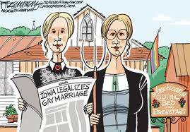
Iowa supreme court
Another way social scientists participated in the Varnum case was by signing onto a friend-of-the-court brief
Social Science Academics and Associations
National Association of Social Workers
American Psychological Association
In the end, the Supreme Court affirmed trial court ruling resulting in marriage equality.

Slide 31
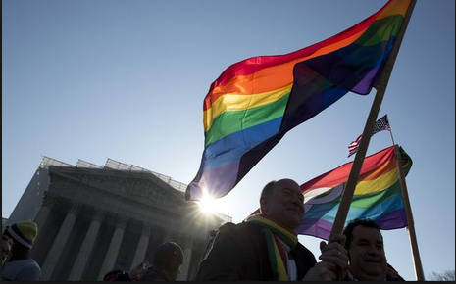
Marriage litigation after varnum
With the success of the Varnum case, the marriage litigation cases that followed also included the social science parenting data
DOMA cases before Supreme Court
Prop 8 case before Supreme Court
Illinois marriage case Darby v. Orr
New Jersey marriage case Garden State Equality, et al. v. Dow, et al.

Slide 32
Using parenting research
Policy & advocacy

Slide 33
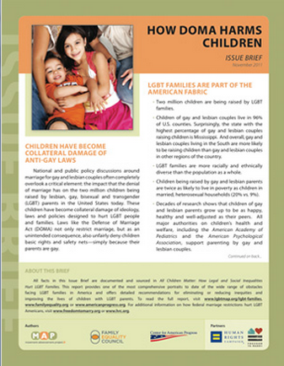
Response from Policy makers
Being able to show that LGBT families s exist → highlight impact of laws
Adoption bans
Marriage and relationship recognition hearings
LGBT families are just like other families
Shift away from whether it is “good for kids” to have LGBT parents
Need legal protections

Slide 34
Double edged sword
using research in policy & advocacy

Slide 35
What makes a good study
Well-articulated research question
Studies what it purports to study
Validated measures
Appropriate data analysis
Apples to apples
But it is harder than it looks!

Slide 36
Challenges in using this work
The public’s understanding of statistics and the research process is limited
Researchers, by default, admit our limitations and are asked to make predictions, broader conclusions about our work
Funding sources can be scrutinized
Notes:
Even when our research is well-designed, there still may be challenges in translating it from the journal to the court room or state capital

Slide 37
Impact of one study
Impact of “poor research” can be far reaching → a single research paper can undermine 30 years of good work
In September 2010, Witherspoon Institute president wrote “It would be great to have this [study] before major decisions of the Supreme Court.”
In April 2011, he further said, “It is essential that the necessary data be gathered to settled the question in the forum of public debate about what kinds of family arrangements are best for society… we are confident that the traditional understanding of marriage will be vindicated by this study as long as it is done honestly and well.”
February 2012, paper was submitted to Social Science Research
March 2012, paper was accepted; July 2012 published
Swift response from academics and professional associations, American Sociological Association
Immediate take up by equality opponents, including in briefs and legislative hearings
Notes:
Paper published last July has really rocked the boat. A UT Professor launched the New Family Structures Study.
Randomly screened over 15,000 Americans aged 18-39 and asked them if their biological mother or father ever had a romantic relationship with a member of the same sex
On 25 of 40 different outcomes evaluated, the children of women who’ve had same-sex relationships fare quite differently than those in stable, biologically-intact mom-and-pop families, displaying numbers more comparable to those from heterosexual stepfamilies and single parents. Even after including controls for age, race, gender, and things like being bullied as a youth, or the gay-friendliness of the state in which they live, such respondents were more apt to report being unemployed, less healthy, more depressed, more likely to have cheated on a spouse or partner, smoke more pot, had trouble with the law, report more male and female sex partners, more sexual victimization, and were more likely to reflect negatively on their childhood family life, among other things.

Slide 38
One bad apple
What was problematic about this study?
Insufficient data
Unvalidated questionnaire
Collapsed variables incorrectly
“Signal in the noise”
Notes:
Insufficient data: 2 of the 85 children who said that they lived at some point with a mother who was romantically involved with another woman did so for the entirety of their childhood.
Unvalidated questionnaire → didn’t use validated measures from psychology or sociology or measures that are easily comparable to other studies → Relied on reports of adult children about their parents’ relationship (did parent have a romantic relationship (of any duration)? Not really about sexual orientation of parents; does not examine children born or adopted into same-sex parent families; instead children who, from the time they were born to age 18, had a parent who at any time was in a same-sex relationship → but called these “lesbian mothers” and “gay fathers”; relied on child’s report; not really “raised by”
S7. From when you were born until age 18 (or until you left home to be on your own), did either of your parents ever have a romantic relationship with someone of the same sex? Yes, my mother had a romantic relationship with another woman Yes, my father had a romantic relationship with another man No
Collapsed variables incorrectly -- Regnerus: Most of these had experienced family dissolution, so stability vs. having same-sex parents (apples to oranges). Split out “intact” heterosexual families vs. single parented/divorced, but grouped together anyone who had a same-sex parent into one group (regardless of family instability).

Slide 39
Need to go deeper and further
More advanced sampling methods
Self-reported data vs. outside
Difficult to get a good “comparison” group
Limited data about gay dads; nothing really about transgender parents
Limited data about adoptive families
Impact of LGBT policies, such as marriage equality

Slide 40
Questions & Discussion

